Slide 1


Hope to Skills
Lecture# 16
Irfan Malik, Dr. Sheraz Naseer

Slide 2
Agenda
Data Science processes

Slide 3
Previous lecture:
Lecture 15 - Data Science
Click Here

Slide 4
Data Science

Slide 5
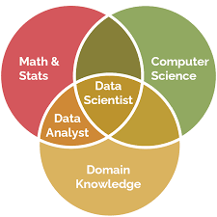
Data Science
Data science is the field of extracting knowledge and insights from data through a blend of statistics, programming, machine learning, and domain expertise.

Slide 6
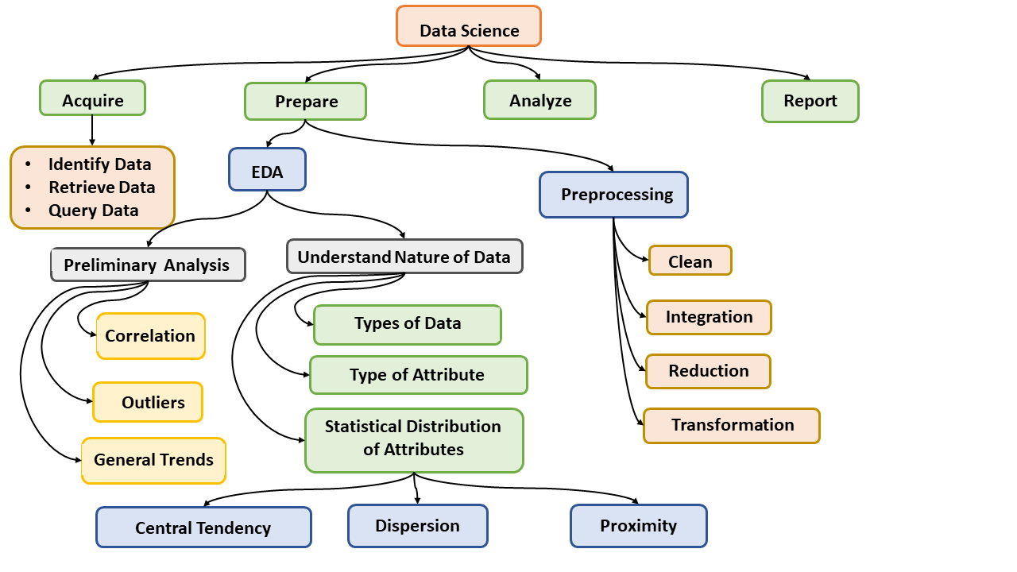
Data Science Processes - I

Slide 7
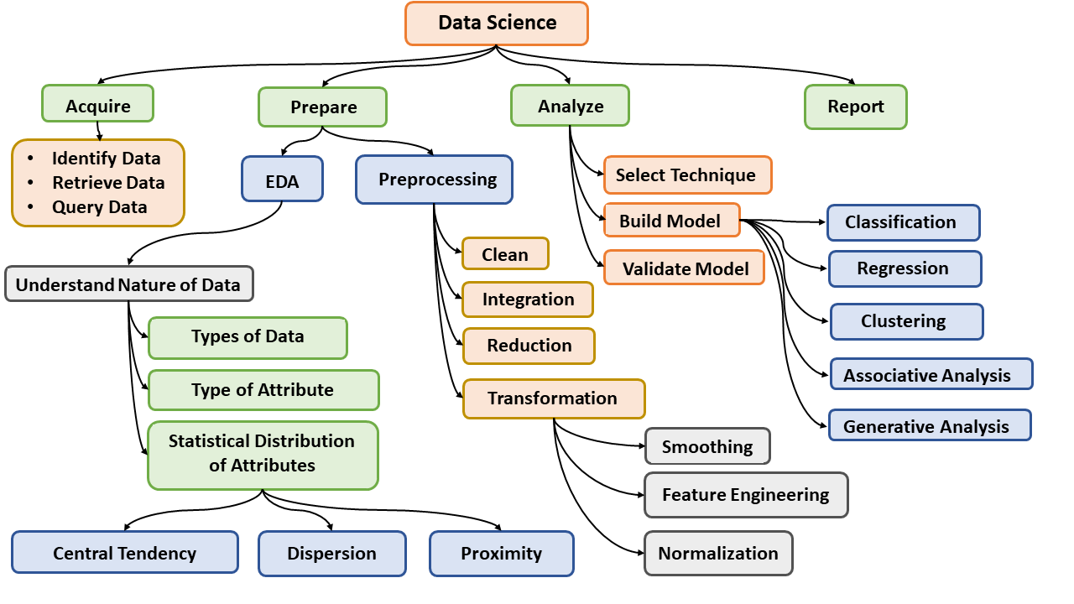
Data Science Processes - II

Slide 8
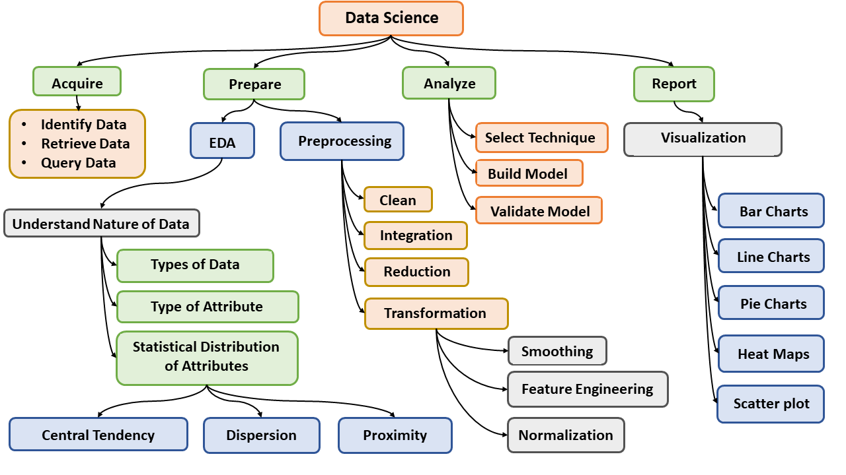
Data Science Processes - III

Slide 9
Data Skewness:
Data skewness is an uneven distribution of data within a dataset. It occurs when certain values or ranges of values appear more frequently than others. This skewness can occur in various dimensions of the dataset, such as columns, partitions, or even individual files.

Slide 10
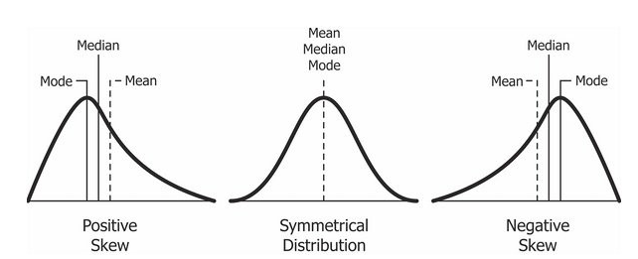
Distributions

Slide 11
Negative Skewness: If the mode is smaller than the mean, the data is positively skewed.
Positive Skewness: If the mean is smaller than the mode, the data is negatively skewed.
Symmetrical Distribution: Mean, median, and mode are all equal; distribution is balanced.

Slide 12
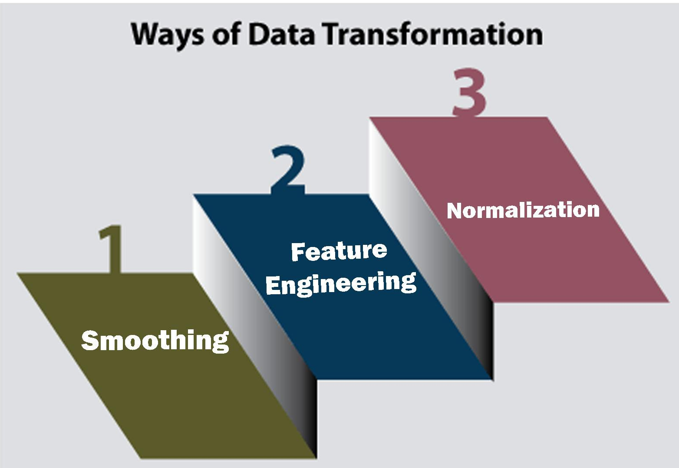
Data Transformation:
Data transformation is the process of converting, cleansing, and structuring data into a usable format that can be analyzed to support decision making processes, and to propel the growth of an organization.

Slide 13
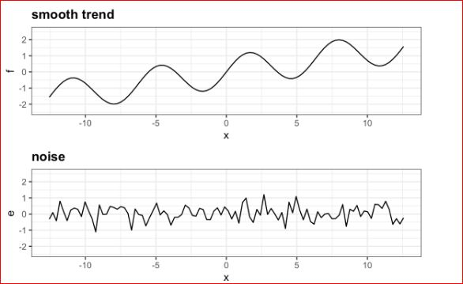
Smoothing:
Smoothing in data preprocessing refers to a set of techniques used to reduce noise and fluctuations in data while preserving important underlying trends and patterns. It is a crucial step in preparing data for analysis and modeling, particularly when dealing with noisy or uneven data points.

Slide 14
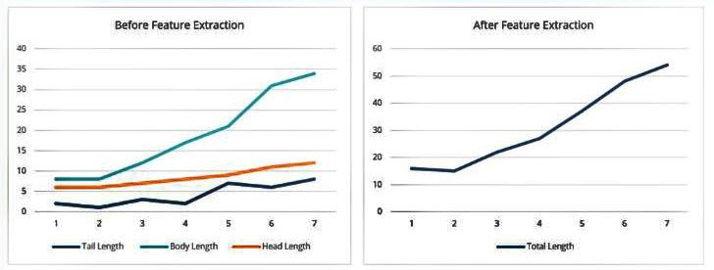
Feature Engineering:
Feature engineering is an essential step in the data science process that involves creating and transforming raw data into features suitable for building machine learning models.

Slide 15
Data Normalization:
Normalization is a data preprocessing technique that transforms data values to a common scale or distribution of values. It can include adjusting the scale of values to a similar metric or adjusting the time scales to be able to compare like periods.

Slide 16
Scaling:
Min Max Scaling
Z-score Scaling

Slide 17
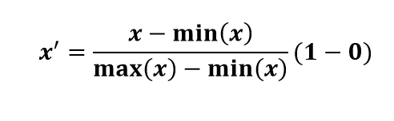
Min-Max Scaling
Min-Max Scaling is a data normalization technique used to transform data into a specific range.
Formula for Min-Max Scaling

Slide 18
Min-Max Scaling- Example
Example: Normalize the data [200, 300, 400, 600, 1000] for interval [0,1]
Step 1: Find the minimum value (min_X) and maximum value (max_X) in the data..
min_X = 200
max_X = 1000
Step 2: Apply the Min-Max scaling formula to each data point:
For x = 200:
Scaled_x = (200 - 200) / (1000 - 200)*(1 - 0) = 0 / 800 = 0

Slide 19
Min-Max Scaling
For x = 300:
Scaled_x = (300 - 200) / (1000 - 200) *(1 - 0) = 100 / 800 = 0.125
For x = 600:
Scaled_x = (600 - 200) / (1000 - 200)*(1 - 0) = 400 / 800 = 0.5
For x = 1000:
Scaled_x = (1000 - 200) / (1000 - 200)*(1 - 0) = 800 / 800 = 1
scaled data: [0, 0.125, 0.25, 0.5, 1]

Slide 20
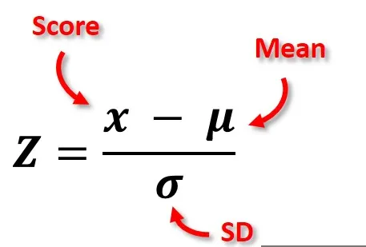
Z-Score scaling
Z-Score Scaling, also known as standardization, is a technique used to transform data into a standard normal distribution.

Slide 21
Z-Score scaling
Example: Normalize the data [200, 300, 400, 600, 1000] using z-score scaling
Step1
Calculate the Mean (μ) of the data.
μ = 500
Step2
Calculate the Standard Deviation (σ) of the data.
σ= 286.4789

Slide 22
Z-Score Scaling
Calculate the Z-Score for each data point:
For x = 200:
z = (200 - 500) / 286.4789 ≈ -1.047
For x = 300:
z = (300 - 500) / 286.4789 ≈ -0.698
For x = 400:
z = (400 - 500) / 286.4789 ≈ -0.349
For x = 600:
z = (600 - 500) / 286.4789 ≈ 0.349
For x = 1000:
z = (1000 - 500) / 286.4789 ≈ 1.747

Slide 23
Data Visualization Charts

Slide 24
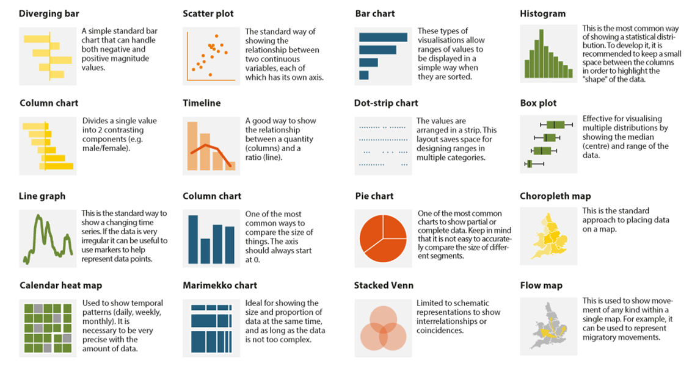

Slide 25
Model Selection:
The process of selecting the machine learning model most appropriate for a given issue is known as model selection.
here are the key steps to choose the best model in machine learning condensed into five points:
Understand the Problem: Clearly define the problem you're solving and determine the type of task (classification, regression, clustering, etc.) you're dealing with.
Explore Model Options: Familiarize yourself with a variety of machine learning algorithms suitable for your problem, considering factors like data size, complexity, and distribution.

Slide 26
Evaluate Performance: Train multiple models and evaluate their performance using appropriate metrics, considering factors like accuracy, precision, recall, etc., depending on your problem type.
Consider Model Complexity: Balance the trade-off between model complexity and interpretability, opting for simpler models if interpretability is crucial or if you have limited data.
Iterate and Optimize: Fine-tune your chosen model's hyperparameters, consider ensemble methods for performance enhancement, and continuously refine your approach based on experimentation and feedback.

Slide 27
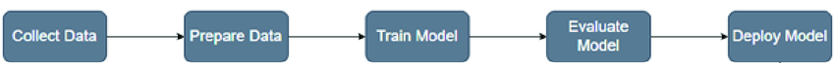
Model Building:
Model building involves the process of selecting and training a machine learning model using a dataset to learn patterns and relationships within the data. This typically includes steps such as preprocessing the data, selecting an appropriate algorithm, splitting the data into training and validation sets, training the model on the training set, and evaluating its performance on the validation set.

Slide 28
Model Validation:
Model validation is a machine learning (ML) process that assesses how well a model can produce predictions or outputs. It's important to validate models before deployment to ensure they're accurate and reliable.

Slide 29
Regression Models

Slide 30
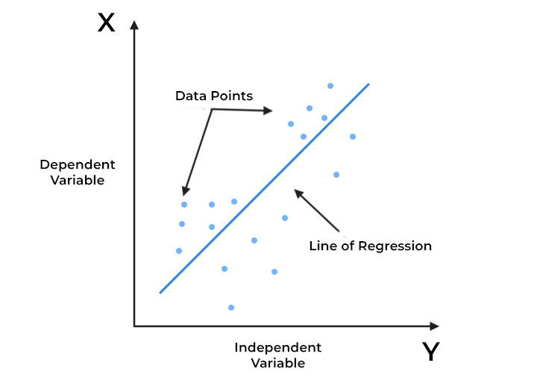
Linear Regression
Linear regression is a supervised machine learning algorithm used for predicting a continuous output (dependent variable) based on one or more input features (independent variables).

Slide 31
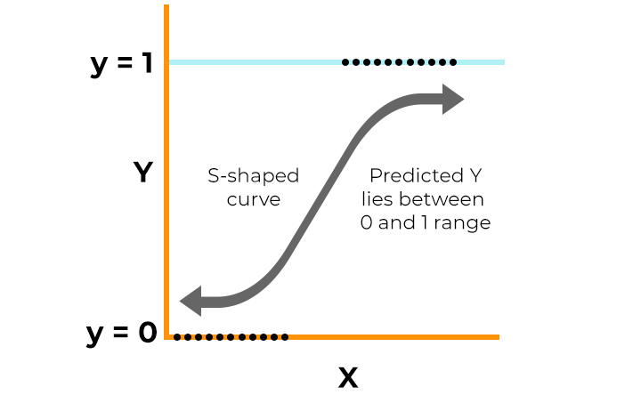
Logistic Regression
Logistic regression is a supervised machine learning algorithm that accomplishes binary classification tasks by predicting the probability of an outcome, event, or observation.

Slide 32
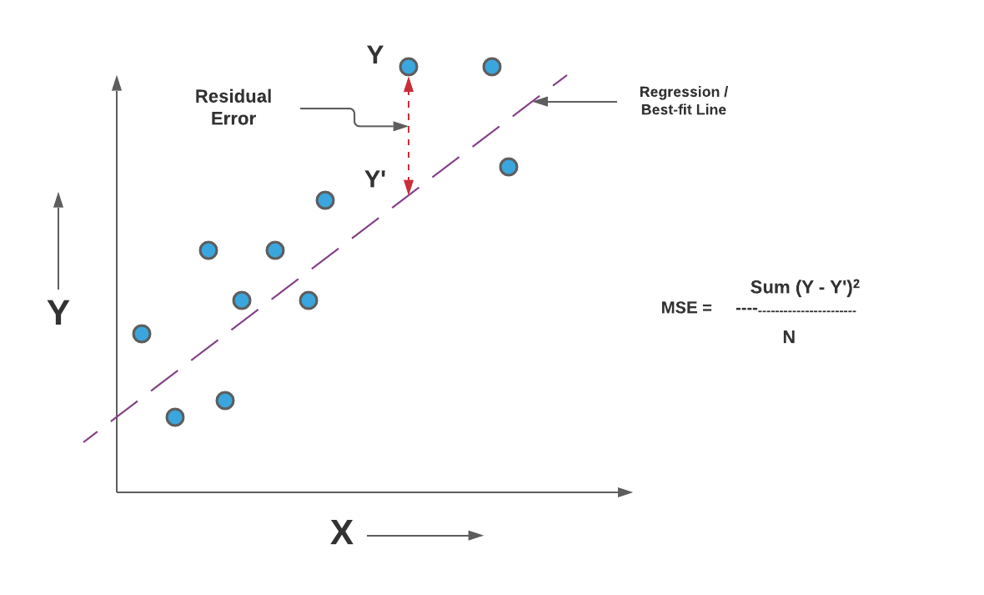
Mean Squared Error (MSE)
The Mean Squared Error (MSE) is a common evaluation metric used in regression tasks.
It measures the average squared difference between the actual and predicted values.

Slide 33
Different Regression Techniques

Slide 34
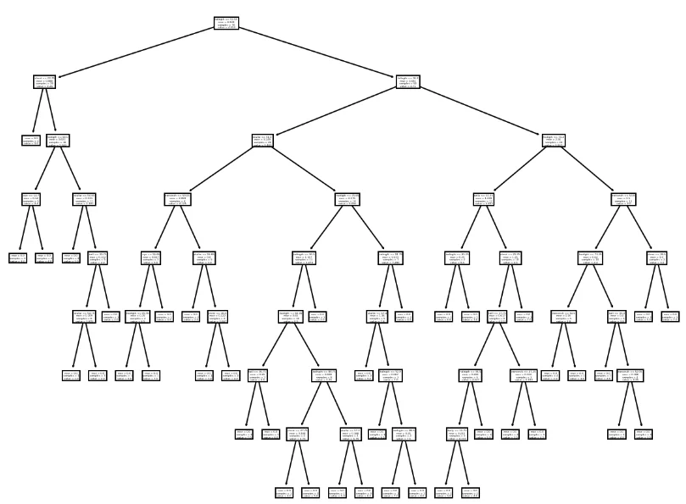
Decision Tree Regressor
Decision tree regression involves partitioning the data into subsets based on the values of independent variables and predicting the average of the target variable for each subset.

Slide 35
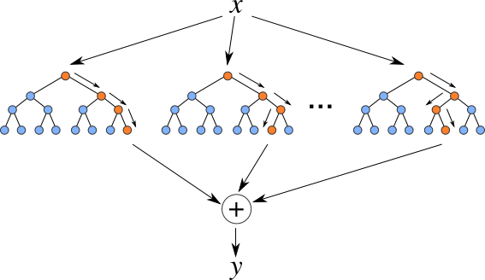
Random Forest Regressor:
Random Forest is learning method that creates multiple decision trees during training and outputs the average prediction (for regression) from all individual trees.

Slide 36
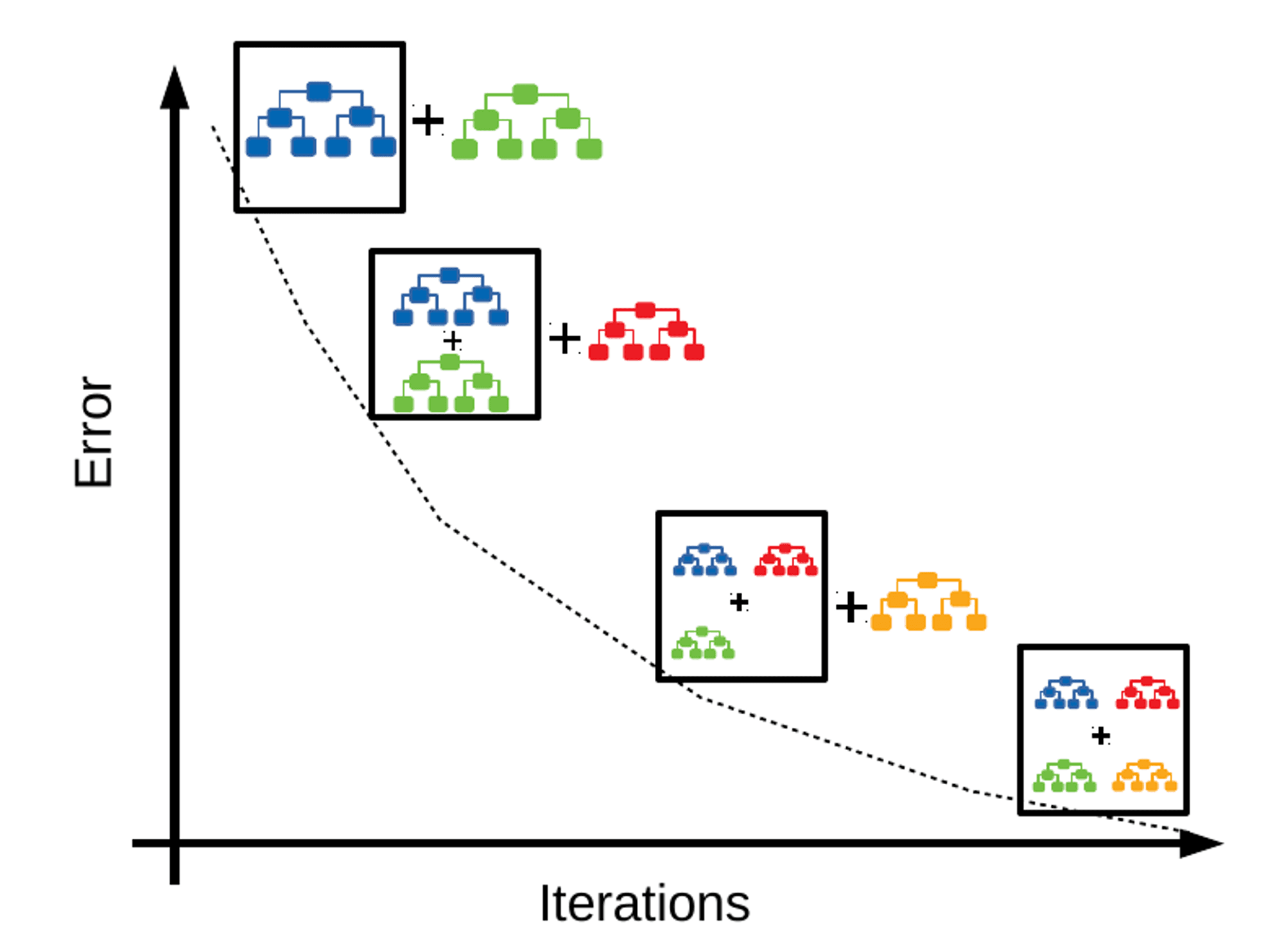
Gradient Boosting Regressor
Gradient Boosting is learning technique that builds multiple decision trees sequentially, each one correcting the errors of its predecessor.

Slide 37
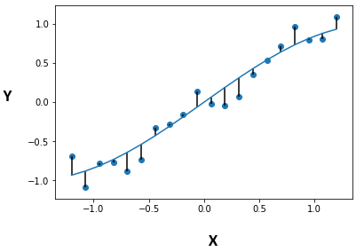
Residual Analysis:
Residual analysis is a technique for evaluating the validity of a linear regression model by examining the patterns of residuals.
A residual is the difference between the observed value and the predicted value of a quantity of interest.

Slide 38
Different Classification Techniques

Slide 39
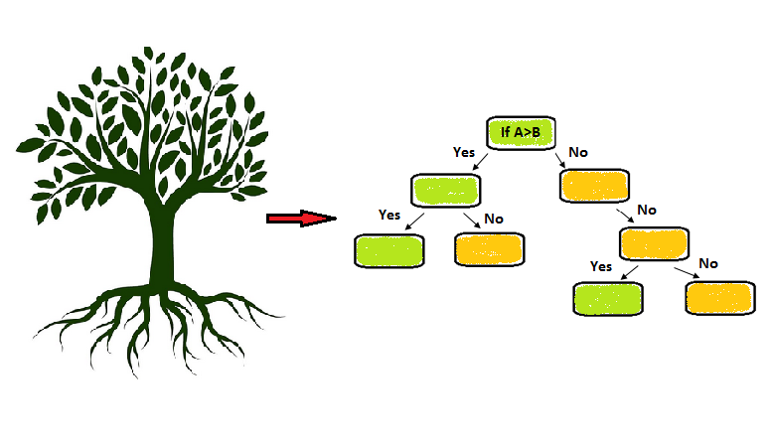
Decision Tree Classifier
A decision tree classifier makes decisions by splitting the data into smaller subsets based on the values of input features, ultimately assigning a class label to each data point. It constructs a tree-like structure of decision rules that can be used for prediction and is easy to interpret.

Slide 40
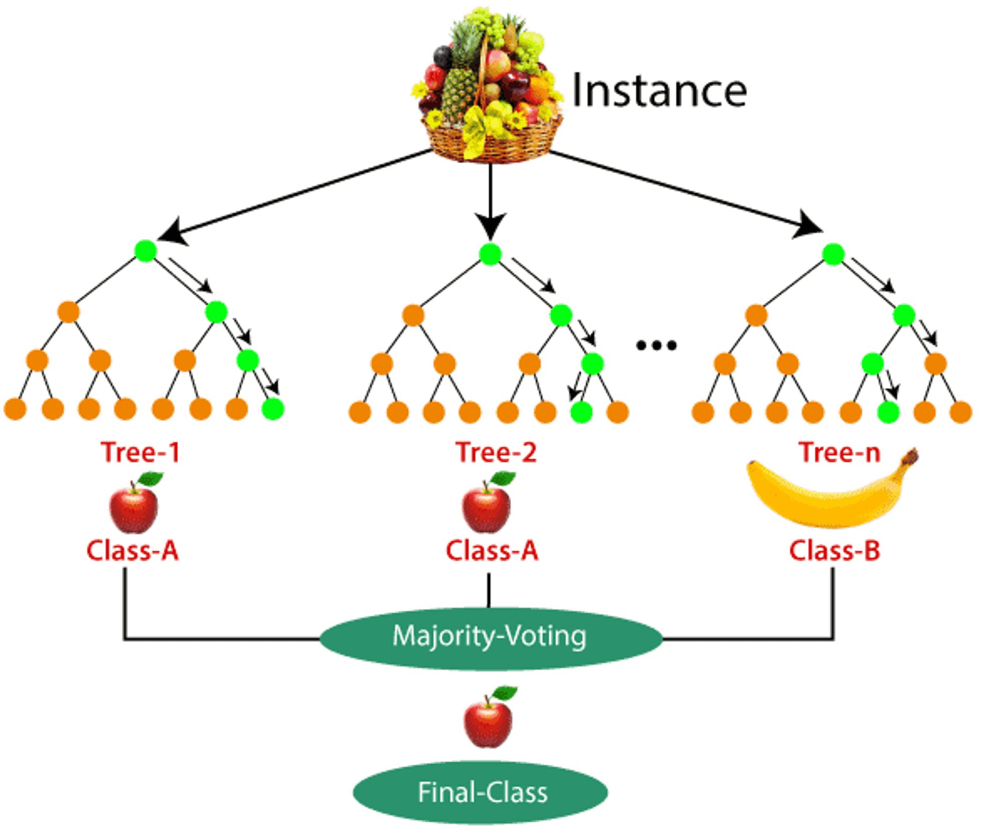
Random Forest Classifier
Random Forest is ensemble learning method that creates multiple decision trees during training and outputs the average prediction from all individual trees.

Slide 41
Gradient Boosting Classifier
Gradient Boosting Classifier is a powerful ensemble learning technique used for classification tasks. It belongs to the class of boosting algorithms, which build a strong predictive model by combining multiple weak learners sequentially.

Slide 42
Support Vector Machines (SVM):
Support Vector Machines (SVM) is a powerful supervised learning algorithm used for both classification and regression tasks.
Regression:
In regression tasks, SVMs aim to find the hyperplane that best fits the data while maintaining a maximum margin.
Classification:
In classification tasks, SVMs aim to find the hyperplane that best separates the data points of different classes in the feature space.

Slide 43
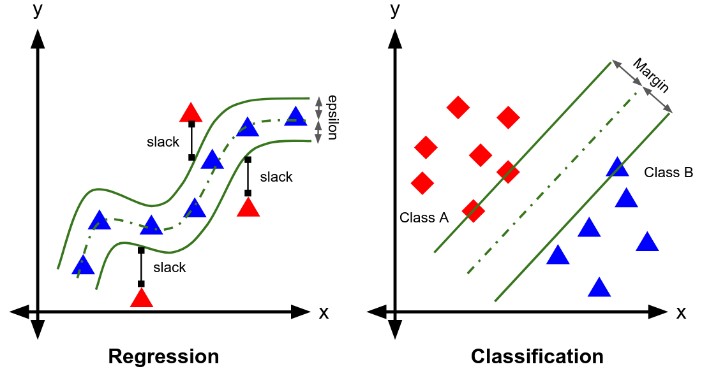

Slide 44
Ensemble:
Ensemble learning is a machine learning technique that combines the predictions of multiple individual models (learners) to improve overall performance and generalization. Instead of relying on a single model, ensemble methods create a "committee" of models and aggregate their predictions to make a final decision.

Slide 45
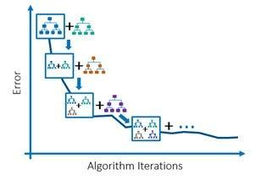
Gradient Boosting classifier
Gradient Boosting is ensemble learning technique that builds multiple decision trees sequentially, each one correcting the errors of its predecessor.

Slide 46
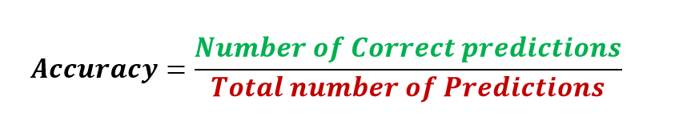
Accuracy
It is the ratio of number of correct predictions to the total number of input samples.
Note:It works well only if there are equal number of samples belonging to each class.

Slide 47
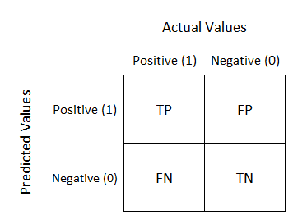
Confusion Matrix
Confusion Matrix as the name suggests gives us a matrix as output and describes the complete performance of the model.

Slide 48
Confusion Matrix
True Positives : The cases in which we predicted YES and the actual output was also YES.
True Negatives : The cases in which we predicted NO and the actual output was NO.
False Positives : The cases in which we predicted YES and the actual output was NO.
False Negatives : The cases in which we predicted NO and the actual output was YES.

Slide 49
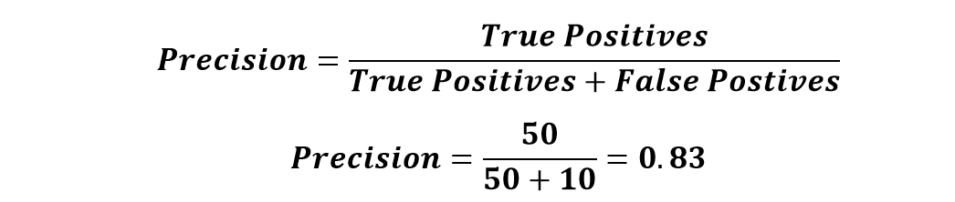
Confusion Matrix - Precision
It is the number of correct positive results divided by the number of positive results predicted by the classifier.
precision emphasizes minimizing false positives.
Use case example: Medical tests, where false positives (Predicted Diseased but actually healthy) can lead to unnecessary treatments.

Slide 50
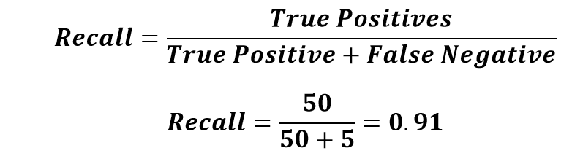
Confusion Matrix - Recall
The ratio of correctly predicted positive instances to the total actual positive instances.
Recall focuses on minimizing false negatives.
Use case example: Disease detection, where False Negative (predicted healthy but actually diseased) can have serious consequences.

Slide 51
Confusion Matrix - Example
Suppose you trained a model to classify cancer patients. You want evaluate the model performance. You have to answer the following questions Accuracy? Precision? and Recall?
What should be of more concerned Accuracy. Precision. Recall?
 | Predicted Cancer = Yes | Predicted Cancer = No
Actual Cancer = Yes | 96 | 11
Actual Cancer = No | 17 | 54

Slide 52
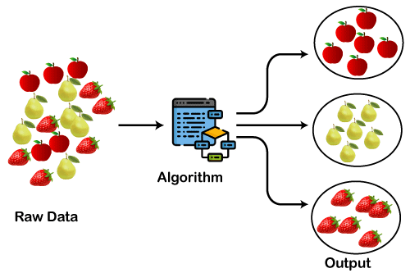
Clustering Models:
Clustering models are used for grouping similar data points together based on their characteristics or features. Unlike classification, clustering is an unsupervised learning technique where the categories are not predefined. Examples include k-means clustering, hierarchical clustering, and DBSCAN.

Slide 53
Associative Analysis
Associative analysis in data science refers to the process of identifying and analyzing relationships or associations between different variables or attributes within a dataset. It aims to uncover patterns, correlations, or dependencies among variables that may not be immediately apparent.

Slide 54
Generative Analysis
Generative analysis in data science refers to a class of statistical techniques and models used to generate new data samples that are similar to an existing dataset.
One common approach to generative analysis is Generative Adversarial Networks (GANs), which consist of two neural networks, a generator and a discriminator, that are trained simultaneously.

Slide 55
Next Lecture:
Lecture 17 - Classification Using Scikit Learn
Click Here

